Slide 1


SNAP ELIGIBILITY PREDICTION BY GEOGRAPHIC REGION
Trish Girmus
DSC 630
August 14, 2021

Slide 2

OVERVIEW
Background of SNAP
Problem Statement
Data used for project
Multiple linear regression performed for statistical analysis
Conclusion of analysis

Slide 3


Project Topic Origination
I grew up in a farm community in south central Nebraska, population 2,400

Slide 4
What Is SNAP?
SNAP stands for Supplemental Nutrition Assistance Program.
The purpose of SNAP is to help families in need by providing supplemental benefits so nutritious food is available, as well as becoming self-sufficient.
SNAP has existed in the U.S. since 1939.
As of June 2021, 21,864,170 households receive SNAP benefits.

Slide 5
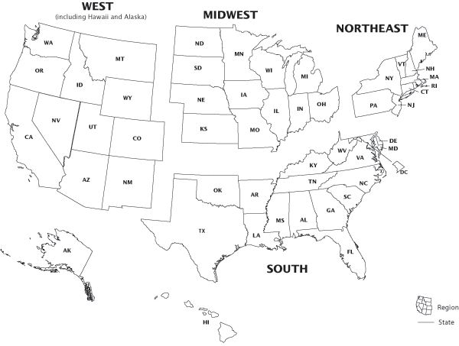
Problem Statement:
Predict if SNAP eligibility assistance distributed is sufficient based where families reside
Geographic regions:
West
Midwest
Northeast
South

Slide 6

FoodAPS Survey
United States Department of Agriculture (U.S.D.A.) conducted a survey from 2012-2013 about food acquisition in American households.
Survey was called Food Acquisition and Purchase Survey (FoodAPS)
4,826 households participated in survey
4 subgroups of households participated

Slide 7

Data Overview
Dataset used for project:
faps_household_puf
Contains 4,826 rows & 279 variables
Data is located on ers.usda.gov

Slide 8

MATH SIPP+ Model
SNAP eligibility monthly estimates for FoodAPS survey used MATH SIPP+ Model
MATH stands for: Micro Analysis of Transfers to Households
SIPP stands for: Survey of Income and Program Participation
SNAP eligibility based on Federal and State rules
Monthly estimates resulted in 4 target variables used for statistical analysis

Slide 9
SNAP Eligibility Results of 4 Target Variables

Slide 10

Target Variables for Analysis
4 Target Variables are used with analysis
Variables are based on 4 different model runs of the map SIPP+ model benefits
BENEST1_HH
BENEST2_HH
BENEST3_HH
BENEST4_HH

Slide 11
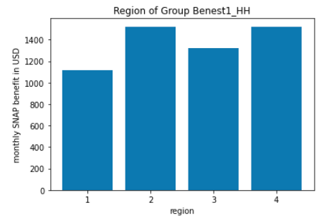
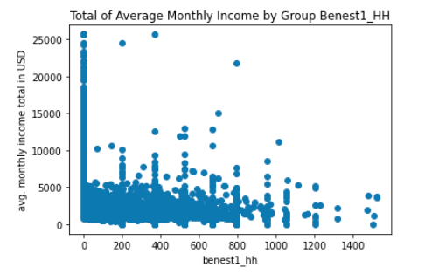
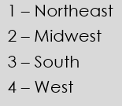
Target Variable BENEST1_HH Visualizations
Monthly SNAP benefits by Region
Average Monthly Income

Slide 12
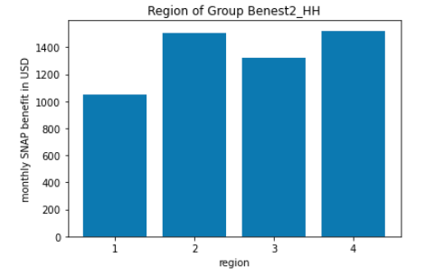
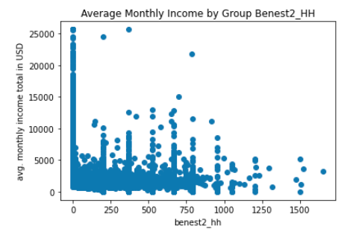
Target Variable BENEST2_HH Visualizations
Monthly SNAP benefits by Region
Average Monthly Income

Slide 13
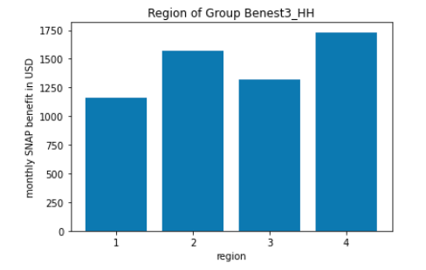
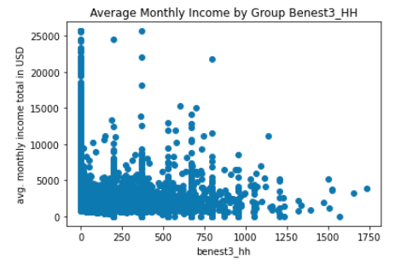
Target Variable BENEST3_HH Visualizations
Monthly SNAP benefits by Region
Average Monthly Income

Slide 14
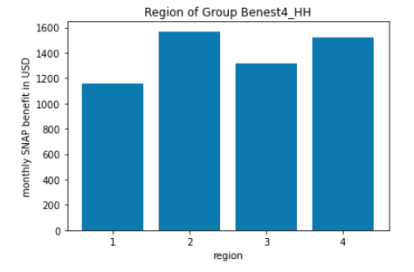

Target Variable BENEST4_HH Visualizations
Monthly SNAP benefits by Region
Average Monthly Income

Slide 15
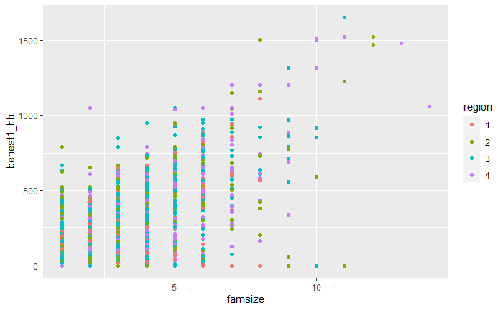
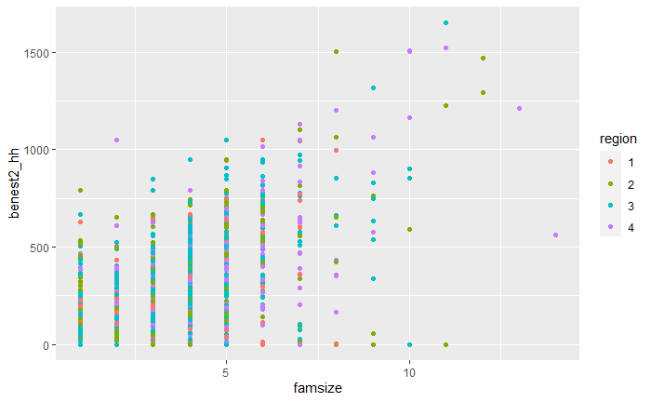
Target Variable BENEST1_HH& BENEST2_HH Visualizations
Family Size by Region – BENEST1_HH
Family Size by Region – BENEST2_HH

Slide 16
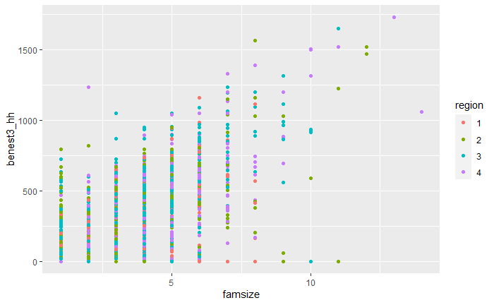
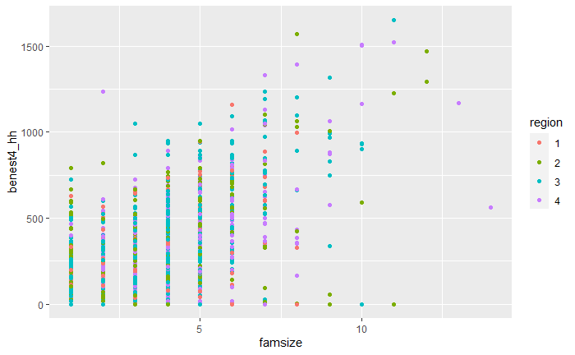
Target Variable BENEST3_HH& BENEST4_HH Visualizations
Family Size by Region – BENEST3_HH
Family Size by Region – BENEST4_HH

Slide 17
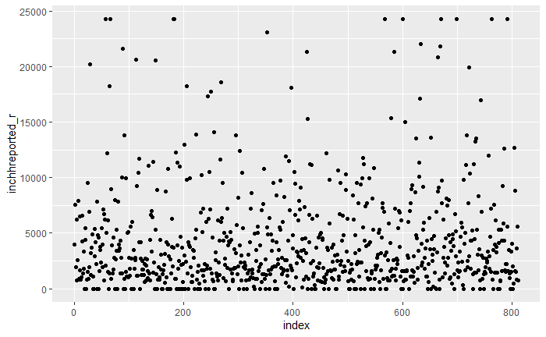
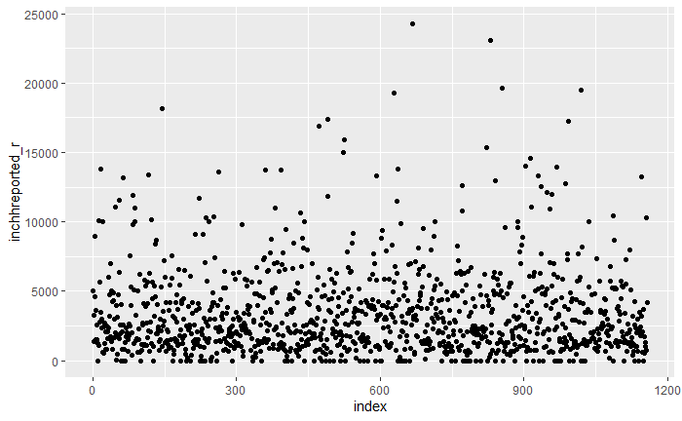
Monthly Income by Region 1 & Region 2
Region 1 - Northeast
Region 2 - Midwest

Slide 18
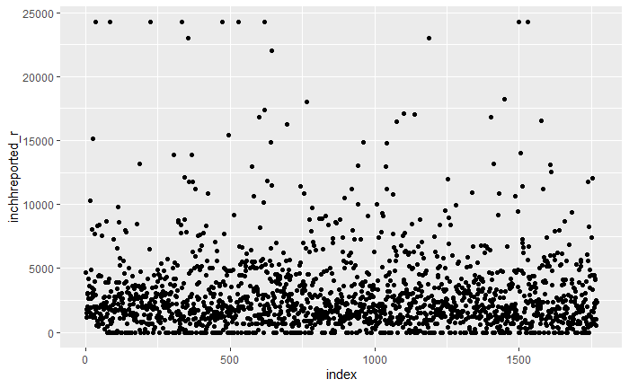
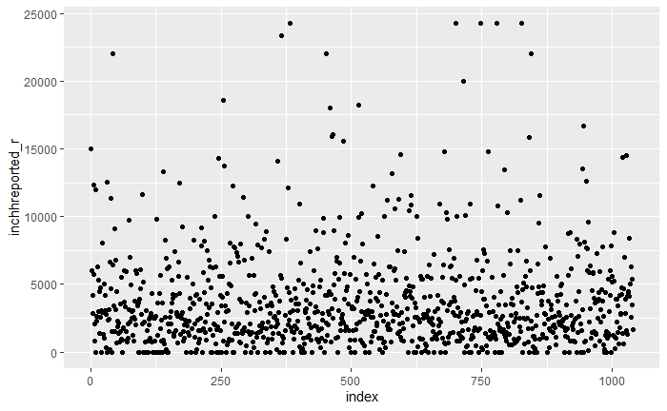
Monthly Income by Region 3 & Region 4
Region 3 - South
Region 4 - West

Slide 19
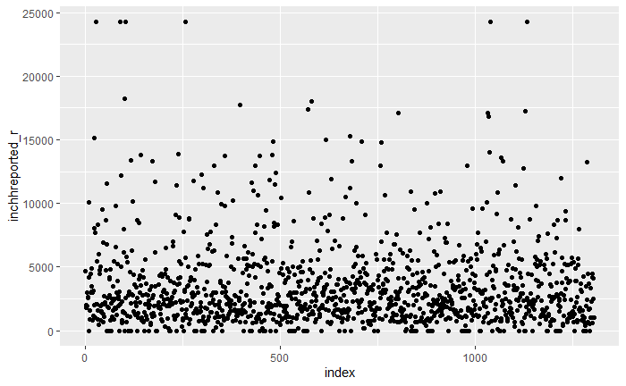
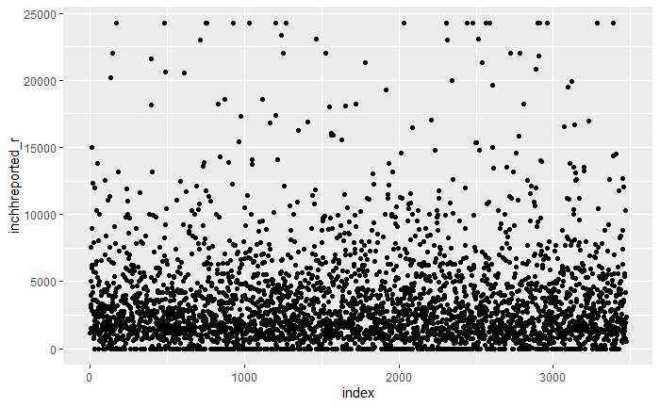
Rural vs. Nonrural Reported Monthly Income
Rural Reported Monthly Income
Nonrural Reported Monthly Income

Slide 20

Preprocessing Data Steps
Data cleaning – removing irrelevant features, missing values
Used dummy encoding to code for categorical variables
Feature extraction & feature selection
Used correlation threshold of .75 to drop features that were highly correlated

Slide 21
Modeling – Linear Regression
Scikit-learn library in in Python was used
Large dataset used for this project / a test and training set were both created
What is Linear Regression?
Ordinary Least Squares (OLS) model used for further analysis. Used statsmodels package in Python.

Slide 22
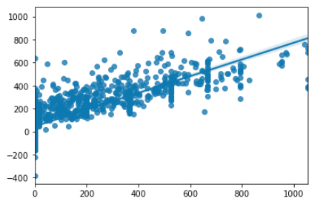
BENEST1_HH Regression Analysis
Regression Analysis Results
BENEST1_HH
Linear Regression model shows a strong relationship with test and predicted values.
Using OLS Regression Results, the R-squared score is 0.727.
The p-value for region 2 is 0.654, region 3 is 0.867, and region 4 is 0.227, which is not statistically significant.

Slide 23
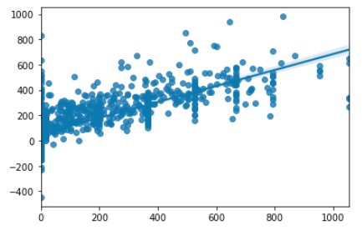
BENEST2_HH Regression Analysis
Regression Analysis Results
BENEST2_HH
Linear Regression model shows a strong relationship with test and predicted values.
Using OLS Regression Results, the R-squared score is 0.637.
The p-value for region 2 is 0.762, region 3 is 0.801, and region 4 is 0.251 which is not statistically significant.

Slide 24
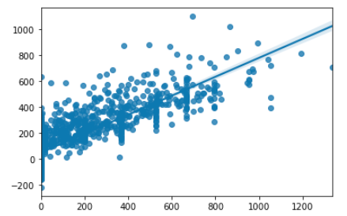
BENEST3_HH Regression Analysis
Regression Analysis Results
BENEST3_HH
Linear Regression model shows a strong relationship with test and predicted values.
Using OLS Regression Results, the R-squared score is 0.741.
The p-value for region 2 is 0.545, region 3 is 0.823, and region 4 is 0.202, which is not statistically significant.

Slide 25
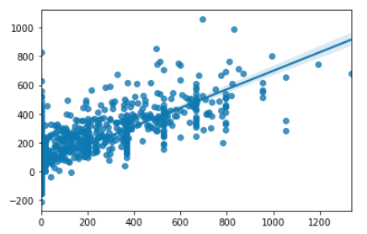
BENEST4_HH Regression Analysis
Regression Analysis Results
BENEST4_HH
Linear Regression model shows a strong relationship with test and predicted values.
Using OLS Regression Results, the R-squared score is 0.664.
The p-value for region 2 is 0.617, region 3 is 0.689, and region 4 is 0.222, which is not statistically significant.

Slide 26

Conclusion
The regression analysis is currently not predicting SNAP eligibility by region based on the p values received by the 4 individual target variables BENEST_HH’s 1, 2, 3, and 4
However, strong significant p values were found from other features which may indicate another type of prediction method could be used
Other ML models could determine whether region is a strong predictor of snap benefits or not

Slide 27
THANK YOU!

Slide 28
REFERENCES
1_Household Codebook PUF.pdf
About ERS. USDA ERS - About ERS. (n.d.). https://www.ers.usda.gov/about-ers/.
Background. USDA ERS - Background. (n.d.). https://www.ers.usda.gov/data-products/foodaps-national-household-food-acquisition-and-purchase survey/background/.
Documentation. USDA ERS - Documentation. (n.d.). https://www.ers.usda.gov/data-products/foodaps-national-household-food-acquisition-and-purchase-survey/documentation/.
https://www.bts.gov/archive/publications/america_on_the_go/us_business_travel/figure_02
https://fns-prod.azureedge.net/sites/default/files/resource-files/34SNAPmonthly-6.pdf
https://www.ers.usda.gov/data-products/foodaps-national-household-food-acquisition-and-purchase-survey/. (n.d.). A Short History of SNAP. USDA. (n.d.).
https://www.fns.usda.gov/snap/short-history-snap. SNAP Data Tables. USDA. (n.d.).
https:// www.fns.usda.gov/snap/supplemental-nutrition-assistance-program
https://mathematica.org/publications/technical-working-paper-creation-of-the-2012-baseline-of-the-2009-math-sipp-microsimulation-model-and-database. (n.d.).
https:// www.oreilly.com/library/view/40-algorithms-every/9781789801217/fa0a5d03-e2a7-4f01-bd9c-53c3f54a7da1.xhtml

